Slide 1
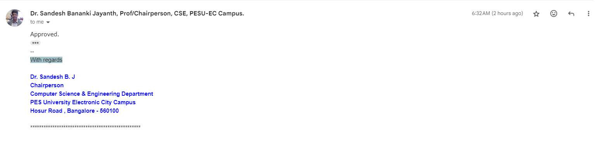
Approval mail for LLD and ppt

Slide 2
Outline
Abstract and Scope of the Project.
Suggestions from Review – 1.
Approach & Architectural Design or Framework.
Project Progress and Demonstration.
Timeline for Pending Tasks.
Conclusion.
References.

Slide 3
Abstract and Scope
The current process of sports summarization relies heavily on manual efforts. Large editing teams manually review entire game footage, select crucial moments, and compile highlights.
This process is not only time-consuming but also resource-intensive, leading to potential uneven coverage of events.
Our project addresses this challenge by proposing a multi-modal approach, leveraging the power of Twitter data, audio features, and video content to automate and enhance the summarization process

Slide 4
UE21CS461A – Capstone Project Phase – 2
Project Progress Review #2
Project Title : Indexing and Summarization of Sports
Videos using Multi-Modal Approach
Project ID : 61
Project Guide : Dr. Sandesh B J
Project Team : PES2UG21CS242 (Krupashree M V)
PES2UG21CS289 (Meenal Bagare)
PES2UG21CS294 (Melvin Jojee Joseph)
PES2UG21CS324 (Naveen Kumar Reddy G)

Slide 5
Abstract and Scope
Purpose:
The purpose of the project is to address the challenges associated with navigating and consuming lengthy sports videos by providing users with an efficient and informative summarization tool. By automating the process of identifying and highlighting key moments, the system aims to streamline the viewing experience and facilitate content discovery.
Benefits:
Enhances accessibility and usability of sports content.
Saves time for users by providing concise summaries.
Enables efficient content navigation and discovery.
Facilitates deeper analysis and understanding of sports events.
Improves user engagement and satisfaction.

Slide 6
Abstract and Scope
Objectives and Goals:
Develop algorithms for multi-modal data analysis, including analyzing peak activity in Twitter streams, Computer Vision, and Audio Analysis.
Implement a user-friendly interface for interacting with the summarization system.
Extract key events from sports videos based on multi-modal insights.
Generate concise and informative video summaries highlighting key moments.
Evaluate the system's performance using relevant metrics and user feedback.
Ensure scalability and adaptability to different sports and events.

Slide 7
Suggestions from Review - 1
Validation of the models that have been developed by checking their performance by testing on multiple sports videos.
Generalizing the models built for all sports.
Making sure to keep integration of all the models in mind.
We were able to achieve the generalization of the modules for Review 2.

Slide 8
Proposed Approach / Methodology
Basic Approach and Results Obtained:
Basic Approach: The basic approach involved traditional methods of sports video summarization, primarily relying on video content analysis to identify key events. This approach might include techniques such as shot boundary detection, scoreboard analysis, and player tracking to extract highlights.
Results Obtained: The basic approach likely yielded satisfactory results in terms of summarizing sports videos to some extent. However, it has some limitations in capturing the broader context of the game, including audience reactions and social media buzz surrounding the event.

Slide 9
Proposed Approach / Methodology
2. Is There a Need for Changing the Approach?:
We believe the approach and the direction of our implementation is right hence, we believe there is no need to change the approach.
3. Details of the New Approach - Benefits:
New Approach: The new approach integrates Twitter data analysis with advanced audio and visual processing techniques to enhance sports video summarization.
Benefits:
Audience Engagement: Incorporating Twitter data allows for capturing audience reactions, sentiments, and discussions related to the game, providing valuable context to the summarization process.
In depth Analysis: By combining multiple modalities such as audio, visual, and textual data, the new approach offers a more comprehensive understanding of the game events, enhancing the quality and relevance of the summaries.

Slide 10
Proposed Approach / Methodology
3. Details of the New Approach - Drawbacks:
Data Volume and Noise: Handling the vast volume of Twitter data and filtering out noise or irrelevant tweets can be challenging.
Time Discrepancies Among Modalities: Time discrepancies among modalities may lead to synchronization challenges, affecting the coherence and accuracy of the generated summaries.
Complexity: Integrating multiple data sources and processing techniques adds complexity to the system.
Computational Resources: Advanced audio and visual processing techniques may require significant computational resources and processing time

Slide 11
Design Approach
Multi-Modal Approach:
Integrates data from multiple sources, including Twitter data analysis , audio and video processing ,and advanced techniques like MSER-based scoreboard identification, large language model(LLM) and computer vision to enhance event matching and scene classification.
By combining different data sources and techniques, the system can capture various aspects of the game, such as important events, commentary insights, and audience reactions, resulting in more engaging highlights.

Slide 12
Design Approach
Benefits of the Multi-Modal Approach:
Comprehensive Analysis: By integrating multiple data sources, the system can provide a more comprehensive analysis of sports events, capturing various aspects from different perspectives.
Enhanced Accuracy: Each modality offers unique insights, enhancing the overall accuracy of the sports summarization process. By combining data from different sources, the system can cross-validate information, resulting in more precise summaries.

Slide 13
Design Approach
Drawbacks of the Multi-Modal Approach:
Complexity: Integrating multiple data sources and techniques adds complexity to the system design and implementation.
Integration Challenges: Ensuring seamless integration and synchronization of data from different sources can be challenging and may lead to technical issues.

Slide 14
Design Constraints, Assumptions & Dependencies
Legal Implications:
1.Compliance with data protection regulations, copyright laws, and terms of service of social media platforms (such as Twitter) is crucial to avoid legal issues.
2.Obtaining necessary permissions and licenses for using copyrighted content (such as sports broadcasts) is essential to ensure legal compliance.

Slide 15
Design Constraints, Assumptions & Dependencies
Usage Limitations:
The project's success may depend on the availability and access to real-time sports data, including Twitter feeds and live video streams.
Dependence on third-party APIs or data sources may introduce usage limitations, such as rate limits or data access restrictions.
Specific Software/Hardware Requirements:
The project may require specialized software tools for video processing, natural language processing (NLP), machine learning, and data visualization.
Hardware requirements may include powerful computational resources for real-time processing, storage, and analysis of large volumes of data.

Slide 16
Design Constraints, Assumptions & Dependencies
Assumptions Made in the Project:
Availability of Data:
The project assumes the availability of sufficient and reliable data sources, including sports broadcasts, Twitter feeds, and scoreboard information.
It assumes that relevant data will be accessible in real-time or with minimal latency to enable timely analysis and summarization.
Consistency in Data Format:
The project assumes a certain level of consistency in the format and structure of data sources, such as standardized Twitter API responses, and scoreboard layouts.
Assumptions may be made regarding the stability.

Slide 17
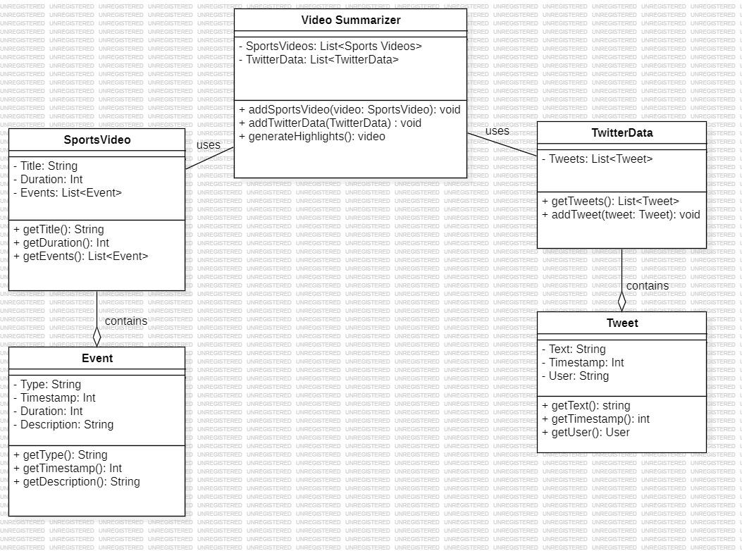
Design Description
Master class diagram

Slide 18
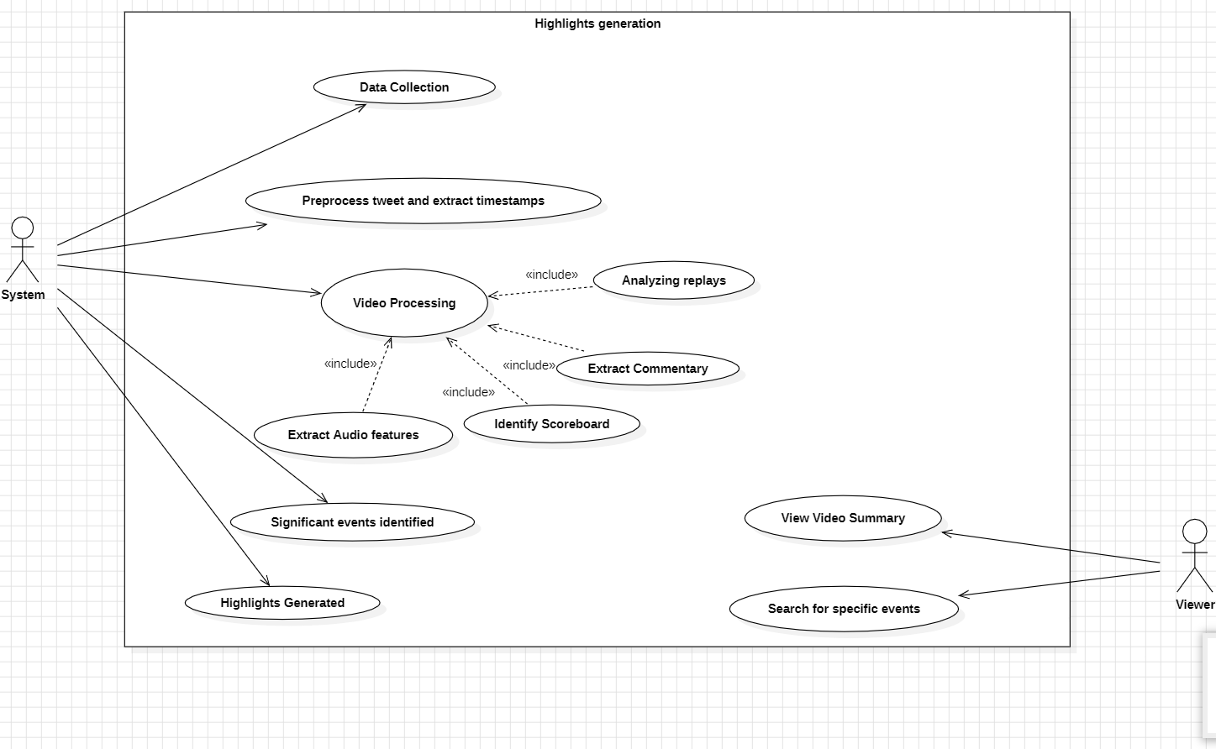
Design Description
Use case diagram

Slide 19
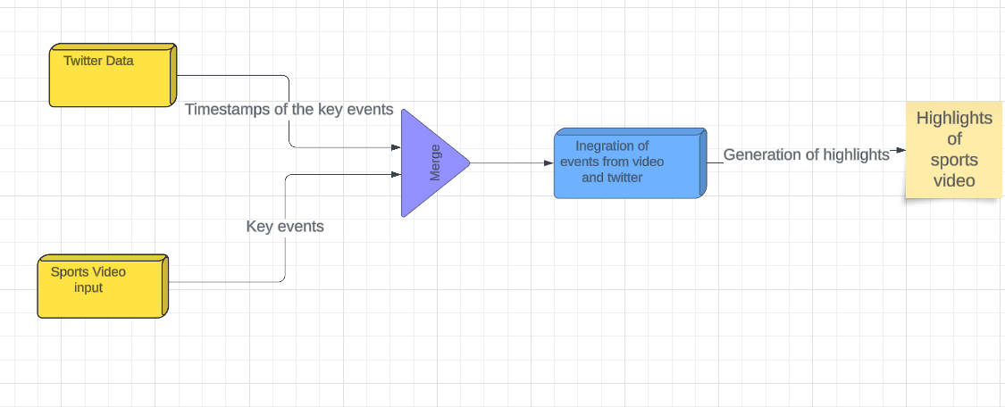
Design Description
External Interfaces

Slide 20
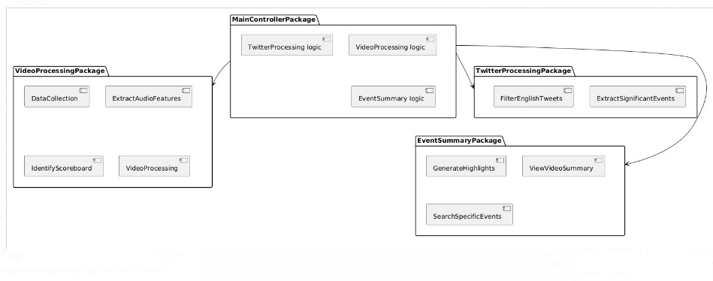
Packaging Diagram

Slide 21
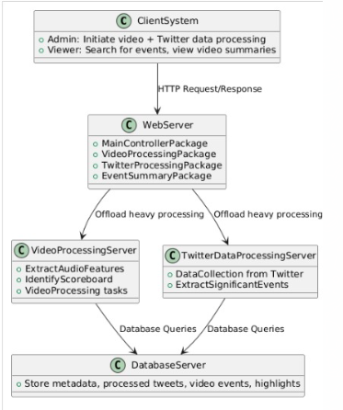
Deployment Diagram

Slide 22
Algorithm & Pseudocode
Data Collection:
Input: 10 videos with audio.
Annotate start and end times of key events (peaks in crowd noise).
Feature Extraction:
Extract audio features (e.g., MFCCs, spectrograms).
Convert each video’s audio into a feature matrix.
Data Labeling:
Use a sliding window to segment audio.
Label each window:
1 if it overlaps with a key event.
0 otherwise.

Slide 23
Algorithm & Pseudocode
Model Training:
Choose a classification model (CNN, RNN, SVM).
Train model using labeled feature data.
Prediction:
Extract features from new audio.
Predict key event windows (1) or no event (0).
Group consecutive predictions into event intervals.
Evaluation:
Compare predicted intervals with ground truth.
Calculate accuracy, precision, recall, and F1-score.
And improve by fine tuning the model.

Slide 24
Pseudocode for Key Event Detection Model Using Audio
def extract_audio_features(audio):
# Extract MFCC, Spectrogram, or other features from the audio
features = extract_features(audio)
return features
def label_data(audio, annotations, window_size):
# Create a sliding window to label the data
labels = []
for t in range(0, len(audio), window_size):
if any(start <= t <= end for start, end in annotations):

Slide 25
Pseudocode for Key Event Detection Model Using Audio
labels.append(1) # Key event
else:
labels.append(0) # No event
return labels
def train_model(features, labels):
# Train the model with the labeled data
model = initialize_model()
model.fit(features, labels)
return model

Slide 26
Pseudocode for Key Event Detection Model Using Audio
def evaluate_model(model, test_features, test_labels, annotations):
predictions = model.predict(test_features)
evaluate(predictions, annotations) # Compare with ground truth
return metrics # Accuracy, precision, recall, etc.
# Main process
videos = load_videos()
annotations = manually_annotate(videos)
for video, annotation in zip(videos, annotations):
audio = extract_audio(video)
features = extract_audio_features(audio)

Slide 27
Pseudocode for Key Event Detection Model Using Audio
labels = label_data(audio, annotation, window_size=1) # 1-second window
train_features.append(features)
train_labels.append(labels)
# Train model
model = train_model(train_features, train_labels)
# Test the model
test_video = load_test_video()
test_audio = extract_audio(test_video)
test_features = extract_audio_features(test_audio)
predictions = model.predict(test_features)

Slide 28
Pseudocode for Key Event Detection Model Using Audio
# Compare predictions with annotations
evaluate_model(model, test_features, test_labels, test_annotations)

Slide 29
Algorithm-Event detection from twitter data
Data Collection:
Input: CSV file of tweets.
Process:->Load tweets.
->Clean data (remove URLs, mentions, hashtags, and stopwords).
->Filter non-English tweets.
Tokenization & Preprocessing:
Process:->Tokenize the cleaned text into words.
->Remove stopwords and irrelevant tokens.
->Group tweets by time into "super documents" representing each time bucket

Slide 30
Algorithm-Event detection from twitter data
Graph Construction:
Input: Super documents (tokens grouped by time bucket).
Process:For each bucket, create a co-occurrence graph where:
Words are nodes.
Edges exist between words that co-occur within a window of size 5.
Edge weights represent co-occurrence frequency.
Growth Factor Calculation:
Input: Sequence of co-occurrence graphs.
Process:For each pair of consecutive graphs:
Compute the sum of edge weights for the current and next time bucket.
Growth factor = Total weight (next) - Total weight (current).

Slide 31
Algorithm-Event detection from twitter data
Aggregated Centrality:
Input: Co-occurrence graphs.
Process:->For each graph, calculate degree centrality for each node (word).
->Sum the centrality values for all nodes to get the aggregated centrality.
Heartbeat Score:
Input: Growth factors and aggregated centralities.
Process:
For each time bucket, compute the heartbeat score as:
Heartbeat score = Growth factor * Aggregated centrality (from next bucket).

Slide 32
Algorithm-Event detection from twitter data
Event Classification:
Input: Heartbeat scores.
Process:->Calculate the absolute difference between consecutive heartbeat scores.
->If the difference exceeds a threshold, label it as a significant event (1), else no event (0).
. Keyword Extraction for Events:
Input: Significant events and corresponding tweets.
Process:->Construct a co-occurrence graph for the event.
->Compute centrality and extract top 10 words as event keywords.

Slide 33
Algorithm-Event detection from twitter data
Visualization:
Input: Heartbeat scores, event labels, and timestamps.
Process:
Plot heartbeat scores over time.
Mark significant events with vertical lines.
Display significant event timestamps.

Slide 34
Pseudocode-Event detection from twitter data
//Load and Clean Data//
Load tweets data from CSV file.
Function: `clean_tweet(text)`
Remove URLs, mentions, and hashtags from the tweet.
Apply `clean_tweet` function to each tweet.
//Language Detection and Filtering//
Function: `is_english(text)` - Detect the language of the tweet. - If language is English, return `True`. - Else, return `False`.
Filter the dataset to retain only English tweets.

Slide 35
Pseudocode-Event detection from twitter data
//Tokenization and Stopword Removal//
Convert cleaned tweets to lowercase.
Remove punctuation and split text into tokens (words).
Remove stopwords using both NLTK stopwords and custom event-related words.
//Time Bucketing//
Convert 'Date Created' column to datetime.
Group tweets by 5-minute intervals.
For each time bucket, combine the tokens from all tweets into a single document.

Slide 36
Pseudocode-Event detection from twitter data
//Create Co-occurrence Graphs//
For each time bucket (super document): - Initialize an empty graph `G`.
For each pair of words within a sliding window: - Add an edge between the words.
If the edge exists, increment its weight. - Append the graph to the list `graphs`.
//Calculate Growth Factor//
Function: `calculate_growth_factor(graphs)`
For each consecutive pair of graphs: - Calculate the total weight of edges in the current and next graph. - Compute the growth factor as the difference in total edge weights. - Return the list of growth factors.

Slide 37
Pseudocode-Event detection from twitter data
//Calculate Aggregated Centrality//
Function: `calculate_aggregated_centrality(graphs)`
For each graph: - Calculate the degree centrality of each node (word).
Sum the centrality values for all nodes to get the aggregated centrality.
Return the list of aggregated centralities.
//Calculate Heartbeat Score//
Function: `calculate_heartbeat_score(GF, AC)`
For each growth factor and the next aggregated centrality: - Compute the heartbeat score as `gf * ac`. Return the list of heartbeat scores.

Slide 38
Pseudocode-Event detection from twitter data
//Classify Events//
Function: `classify_events(heartbeat_scores, threshold=10000)`
For each consecutive pair of heartbeat scores: - If the change in heartbeat score exceeds the threshold, classify as a significant event (label = 1).
Else, classify as no event (label = 0).
Return the list of event labels.
//Extract Significant Events//
Extract time buckets labeled as significant events.
- For each significant event: - Rebuild the co-occurrence graph.

Slide 39
Pseudocode-Event detection from twitter data
- Calculate the degree centrality of each word. - Sort nodes by centrality and extract the top 10 words as keywords. - Append the timestamp and keywords to the list of significant events.
//Plot Heartbeat Scores//
Function: `plot_heartbeat_scores(heartbeat_scores, event_labels, timestamps)`
Plot the heartbeat scores over time.
Mark significant events with vertical lines and annotations.
Display significant timestamps after the plot.

Slide 40
Algorithm & Pseudocode- ScoreBoard Detection and Extraction
Algorithm:
Input:
A soccer sports video.
YOLOv4 model with trained weights for scoreboard detection.
OCR library (e.g., Tesseract) for text extraction from the scoreboard.
Output:
Extracted details: team names, scores, and game time from the scoreboard in each frame of the video.

Slide 41
Algorithm & Pseudocode- ScoreBoard Detection and Extraction
Step 1: Initialize YOLOv4 Model
Load the YOLOv4 configuration (cfg), the pre-trained weights, and the class names for object detection.
Set detection confidence threshold to filter out low-confidence detections.

Slide 42
Algorithm & Pseudocode- ScoreBoard Detection and Extraction
Step 2: Process Video Frames
For each frame in the input video:
Detect the scoreboard:
Run the YOLOv4 model on the current frame to identify bounding boxes.
Filter the results based on the confidence threshold and class (i.e., scoreboard).
If scoreboard detected:
Extract the bounding box coordinates (x, y, width, height) of the detected scoreboard.
Crop the image to focus only on the region inside the bounding box (Region of Interest - ROI).

Slide 43
Algorithm & Pseudocode- ScoreBoard Detection and Extraction
3. Preprocess the cropped image:
Convert the cropped scoreboard image (ROI) to grayscale.
Apply thresholding or other preprocessing techniques to enhance text visibility for OCR.
4. Apply OCR:
Use OCR to extract text from the preprocessed scoreboard image.
The OCR will return a string with the detected characters (team names, scores, and game time).

Slide 44
Algorithm & Pseudocode- ScoreBoard Detection and Extraction
Step 3: Extract Team Names, Scores, and Time
For each line of text extracted by OCR:
Identify team names:
Use predefined patterns or a list of team names to match possible team names.
If a match is found, store the team names.
Identify scores:
Search for numeric patterns in the text that match typical score formats (e.g., 0-9).
Extract and store the scores corresponding to each team.
Identify game time:
Search for time formats, such as MM:SS (minutes ), or other formats used in soccer scoreboards.
Extract and store the game time.

Slide 45
Algorithm & Pseudocode- ScoreBoard Detection and Extraction
Step 4: Store and Record Results
For each frame, store the extracted information: team names, scores, and game time.
Save the extracted details in a structured format (e.g., JSON, text file) for each frame or display them in real time.
Step 5: Summarize Results
After processing all frames:
Aggregate the scoreboard data for summarization.
Generate a summary or a highlight video using the stored team names, scores, and times.
Step 6: End

Slide 46
Algorithm & Pseudocode- ScoreBoard Detection and Extraction
Pseudocode:
// Initialize YOLOv4 model and load weights
Initialize YOLOv4 model with configuration (cfg) and weights
Set confidence threshold for YOLOv4
// Load video file for scoreboard detection
For each frame in the video:
// Detect the scoreboard in the current frame
Detect bounding boxes using YOLOv4
If bounding box detected:
// Crop the detected scoreboard region
Extract the region of interest (ROI) from the frame using the bounding box coordinates

Slide 47
Algorithm & Pseudocode- ScoreBoard Detection and Extraction
// Preprocess the cropped scoreboard image for OCR
Convert ROI to grayscale
Apply thresholding or other image preprocessing techniques for OCR optimization
// Apply OCR to extract text from the scoreboard
Run OCR (Tesseract or other OCR library) on the preprocessed ROI
Extract text from OCR output

Slide 48
Algorithm & Pseudocode- ScoreBoard Detection and Extraction
// Parse extracted text to retrieve scoreboard details
For each line of extracted text:
If text matches a team name format:
Extract team names
If text matches a score format (e.g., digits):
Extract respective scores for each team
If text matches a time format (e.g., minutes and seconds):
Extract the game time
// Store extracted scoreboard details (time, team names, scores)
Save extracted details for this frame

Slide 49
Algorithm & Pseudocode- ScoreBoard Detection and Extraction
Else:
// No scoreboard detected, skip to the next frame
Continue to the next frame
// Summarize results
For each frame with extracted details:
Store or display the extracted scoreboard data (time, teams, scores) as part of the video summary
// End of video

Slide 50
Algorithm & Pseudocode- Event Classification using LLM
model_name = "bert-base-uncased"
max_length = 512
from transformers import AutoTokenizer, AutoModelForSequenceClassification
tokenizer = AutoTokenizer.from_pretrained(model_name)
model = AutoModelForSequenceClassification.from_pretrained(model_name, num_labels=11)

Slide 51
Algorithm & Pseudocode- Event Classification using LLM
train_dataset = train_dataset.map(lambda e: tokenizer(e["text"], padding='max_length', truncation=True), batched=True)
training_args = TrainingArguments(
output_dir="./bert_results",
num_train_epochs =5,
per_device_eval_batch_size=16,
evaluation_strategy='epoch',
logging_dir='./bert_logs',
logging_steps=10,
)

Slide 52
Algorithm & Pseudocode- Event Classification using LLM
trainer = Trainer(
model=model,
args=training_args,
train_dataset=train_dataset,
eval_dataset=train_dataset,
compute_metrics=compute_metrics
)
trainer.train()

Slide 53
Project Progress So far
All the individual modalities are ready and need to be integrated together.
70% of the project has been completed.
The next stage of our Capstone project would include integration of the modalities and validation of the project as a whole.

Slide 54
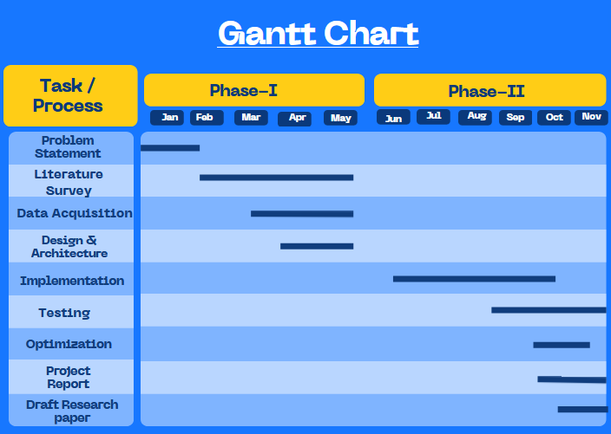
Timeline – Update on Pending Tasks

Slide 55
Conclusion
We have successfully implemented 70% of our project.
We aim to integrate the individual components together and present the project as a whole by the next review.
Successfully generalized our modalities to handle multiple sports in order to be able to apply them to multiple sports in order to generate their highlights or summarization videos.

Slide 56
References
Hirasawa K, Maeda K, Ogawa T, Haseyama M. Detection of Important Scenes in Baseball Videos via a Time-Lag-Aware Multimodal Variational Autoencoder. Sensors (Basel). 2021 Mar 14;21(6):2045. doi: 10.3390/s21062045. PMID: 33799412; PMCID: PMC7999231.
A. Javed, K. B. Bajwa, H. Malik and A. Irtaza, "An Efficient Framework for Automatic Highlights Generation from Sports Videos," in IEEE Signal Processing Letters, vol. 23, no. 7, pp. 954-958, July 2016, doi: 10.1109/LSP.2016.2573042
H. Sattar, M. S. Umar, E. Ijaz and M. U. Arshad, "Multi-Modal Architecture for Cricket Highlights Generation: Using Computer Vision and Large Language Model," 2023 17th International Conference on Open Source Systems and Technologies (ICOSST), 2023, pp. 1-6, doi: 10.1109/ICOSST60641.2023.10414235
Z. Saeed, R. Ayaz Abbasi, M. I. Razzak and G. Xu, "Event Detection in Twitter Stream Using Weighted Dynamic Heartbeat Graph Approach [Application Notes]," in IEEE Computational Intelligence Magazine, vol. 14, no. 3, pp. 29-38, Aug. 2019, doi: 10.1109/MCI.2019.2919395

Slide 57
References
5 . Raj, R., Bhatnagar, V., Singh, A. K., Mane, S., & Walde, N. (2021, January 21).
“Video Summarization: Study of various techniques”. arXiv.org. https://arxiv.org/abs/2101.08434
6 . “Video Summarization Study Of Various Techniques” Proceedings of IRAJ International Conference,26th May, 2019
7. Z. Saeed, R. Ayaz Abbasi, M. I. Razzak and G. Xu, "Event Detection in Twitter Stream Using Weighted Dynamic Heartbeat Graph Approach [Application Notes]," in IEEE Computational Intelligence Magazine, vol. 14, no. 3, pp. 29-38, Aug. 2019, doi: 10.1109/MCI.2019.2919395

Slide 58
Thank You

